Slide 1
Killing of 17 Aid Workers at
Muttur, Sri Lanka in Early August 2006
Conduct of Forensic Examinations and Findings :
Difference of opinion between the
Sri Lankan Government Analyst
(Ballistics Expert – Mr. W.D.G.S. Gunatilleke) and
Australian Forensic Pathologist (Dr. M.J. Dodd)

Slide 2
History in Brief with regard to the Post-Mortem Examinations
Post-Mortems in connection with the 17 bodies of the Aid Workers commenced on the 8th of August 2006 at 11am at the General Hospital, Trincomalee and were concluded that evening.
These Post-Mortem examinations were conducted by Dr. D.L. Waidyaratna, Consultant JMO. No projectiles were recovered on that occasion.
This is attributed to the lack of lack of X-Ray facilities at the Trincomalee General Hospital.

Slide 3
History in Brief …..cont.
On an initiative by the Government of Sri Lanka, the Australian Government agreed to provide technical assistance with regards to further forensic examinations. Based on MOU agreed to by the two governments, the Australian Government made available the services of Forensic Pathologist Dr. M. Dodd to provide necessary technical cooperation.
It was decided by the Investigators to cause an exhumation of the bodies that had by that time been interred, and have a second set of post mortem examinations done. Accordingly, 11 bodies were exhumed and post mortems were conducted by Dr. Waidyaratne, in the presence of Dr. Dodd.
The Post-Mortem examinations of these 11 bodies were performed on 24th and 25th October 2006, by Dr. Waidyaratne at the Colombo Consultant JMO’s Office, with all necessary facilities including an X-Ray machine.

Slide 4
Items Recovered from the bodies at the Post-Mortem examinations on 24th and 25th, October 2006
At the Post-Mortem examinations, foreign objects and fragments of metal had been noticed only in seven bodies. Those had been removed, numbered and packed according to the order given below.
1) Yogaraja Kotheeswaran one object
2) Yogaraja Kotheeswaran three fragments
3) Vairamuththu Kokilawathani one fragment
4) Muththulingam Narmathan one object
5) Sivapragasam Romila one fragment
6) Sivapragasam Romila one object
7) Sivapragasam Romila one object
8) Ravichandra Rishikesan one object
9) Ganesh Kavitha one object
10)Thurairajah Pratheepan one object

Slide 5
Results of the examination of the Object marked as Item (7) recovered at the Post-Mortem of Sivapragasam Romila
According to Dr. Dodd (Australian Forensic Pathologist), at p.44 of his Report :
“ There is however a minimally deformed 5.56 calibre projectile within the cranium.”
He observes further at p.44 :
“ Metallic fragment possibly representing tip of 5.56 calibre projectile (cranium) ”
The Sri Lankan Forensic Pathologist did not venture to express his opinion regarding the identification of any of the projectiles, as that was a matter for a Ballistics Expert.

Slide 6
Results of Item (7) ……Cont.
Mr. W.D.G.S. Gunatilleke (Ballistics Expert), Deputy Government Analyst/Head of Forensic Science Division in his Report dated 19-02-2007 states:
“The core of the bullet marked Item (7) is similar by weight, dimensions and shape to a core of a standard bullet of a cartridge of the caliber of 7.62x39mm.”
“In view of the size, shape and the nature of this object, it cannot be scientifically stated whether this fragment is part of a bullet of either a 7.62mm or 5.56mm caliber or a fragment of a bullet of some other caliber.”

Slide 7
Comparison of results with the standard NORINCO Ammunitions of the Caliber of
7.62x39 mm and 5.56x45 mm.
 | Sample Object (No.7) | Core of 7.62x39mm Bullet | 5.56x45mm Bullet
Weight (g) | 3.59 | 3.6 | 3.5
Length (mm) | 20 | 20 | 19
Base Diameter (mm) | 5.7 | 5.7 | 5.6
Shape | Cylindrical Body | Cylindrical Body | Tapered to a fairly
 | Tapered to a Flat Nose | Tapered to a Flat Nose | Pointed Tip
Shape of the Tip | Flat Nose | Flat Nose | Fairly Pointed
Shape of the Base | Flat | Flat | Hollow
Nature of the Material | Hard Metal, Fairly Rusted in certain Areas, Generally Smooth, Even Surface, Ferromagnetic | Hard Metal, Generally smooth,Even Surface, Ferromagentic | Copper Alloy Jacket, Non-Ferromagnetic

Slide 8
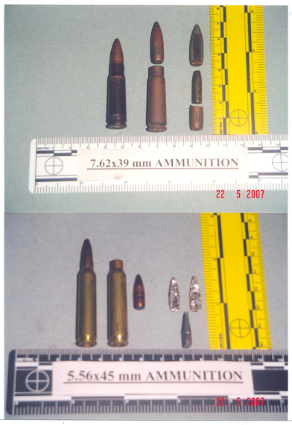
Images of a 7.62x39 mm Bullet and a 5.56x45mm Bullet

Slide 9
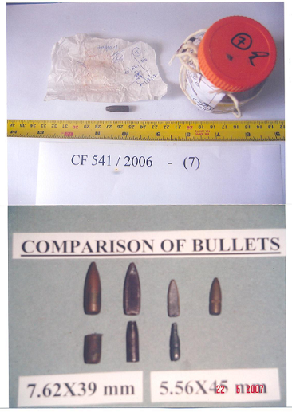
Images…….contd.

Slide 10
CONCLUSIONS
When a bullet is discharged from a rifled bore weapon, the outer surface of the bullet is engraved by the lands and grooves of the barrel.
The chart clearly confirms that Item 7 is not a complete bullet which had been discharged from a rifled bore weapon.
Furthermore, hard metal such as steel is not used in a bullet without a soft metal jacket for rifled bore arms as it damages the rifling (Lands and Grooves) in the barrel when it is driven through the bore.

Slide 11
CONCLUSIONS…..cont.
The phenomenon of separation of the core of the bullet from the outer jacket is not something abnormal.
This has been observed in a number of cases of shooting especially when the shots of the caliber of 7.62x39mm had been fired through hard surfaces such as the body of a vehicle.
In view of the results of the comparison and all the facts mentioned above it is confirmed that the object which had been recovered from the body of Sivapragasam Romila marked as item No. (7) is a core of a bullet.

Slide 12
CONCLUSIONS…..cont.
Item 7 is similar by weight, nature of the material, dimensions and shape to a core of a standard bullet of a Norinco cartridge of the caliber of 7.62x39mm.
Therefore, it is not a complete bullet of a cartridge of the caliber of 5.56x45mm.
The Further Report prepared by Mr. Gunatilleke clearly indicates that the productions had not been tampered with after they were sealed by Dr. Waidyaratne (in the presence of Dr. Dodd) and sent to the Government Analyst through the Magistrates Court.

Slide 13
The Government of Sri Lanka greatly appreciates the assistance provided by the Australian Government and thanks Dr. M. Dodd for his services.
The GoSL has received a request from the Australian Government to make available certain imagery taken of the projectiles on the occasion of their recovery at the 2nd Post Mortems. The GoSL will immediately make available to the Australian Government the required material.
Similarly, the GoSL has requested the Australian Government to make available photographs taken by Dr. Dodd.
It is believed that, a comparison of these photographs would enable the two experts to reconcile their opinion regarding the disputed projectile.

